Slide 1
FILE SYSTEM IN LINUX
GROUP 2
CAPGEMINI INDIA PVT LIMITED
24/3/2018

Slide 2
GROUP MEMBERS
Menaga -093959
Navya Rani -093953
Ayub Nadaf -094047
Prem Singh Rawat -093999
Mohammad Abdul Jabbar -093958
Raj Subash B -093964

Slide 3
FILE
The regular file is a most common file type found on the Linux system.
It governs all different files such us text files, images, binary files, shared libraries, etc.
Most files are just files, called regular files.
They contain normal data, for example text files, executable files or programs, input for or output from a program

Slide 4
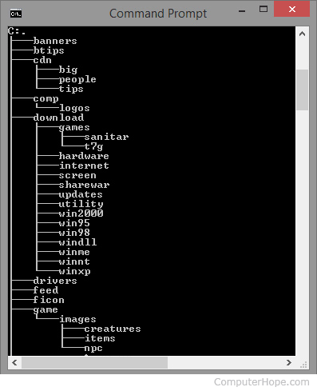
DIRECTORY
A directory is a location for storing files on your computer. Directories are found in a hierarchical file system, such as Linux, MS-DOS, OS/2, and Unix.

Slide 5
BOOT BLOCK
An area of a disk having information for loading the operating system that is needed to start a computer.
Boot Block(s) Blocks on a Linux (and often a Unix) filesystem are 1024 bytes in length, but may be longer or shorter. The blocks are normally a power of 2 in size (1024 is 2 to the 10th power).
Some systems use 512 bytes (2 to the 9th) but 2048 and 4096 are also seen.

Slide 6
SUPERBLOCK
Each file system is different and they have type like ext2, ext3 etc. Further each file system has size like 5 GB, 10 GB and status such as mount status.
In short each file system has a superblock, which contains information about file system such as:
File system type
Size
Status
Information about other metadata structures
If this information lost, you are in trouble (data loss) so Linux maintains multiple redundant copies of the superblock in every file system. This is very important in many emergency situation,
for example you can use backup copies to restore damaged primary super block. Following command displays primary and backup superblock location on /dev/sda3:

Slide 7
DATA BLOCK
Data block is the block which contain data.
Some common characteristics:
They can link to each other, for reuse and instancing.
(child/parent, object/object-data, with modifiers and constraints too).
Their names are unique.
They can be added/removed/edited/duplicated.
They can be linked between files (only enabled for a limited set of data-blocks).

Slide 8
JOURNALING FILE SYSTEM
A journaling file system is a file system that keeps track of changes not yet committed to the file system's main part by recording the intentions of such changes in a data structure known as a "journal", which is usually a circular log.
In the event of a system crash or power failure, such file systems can be brought back online more quickly with lower likelihood of becoming corrupted.

Slide 9
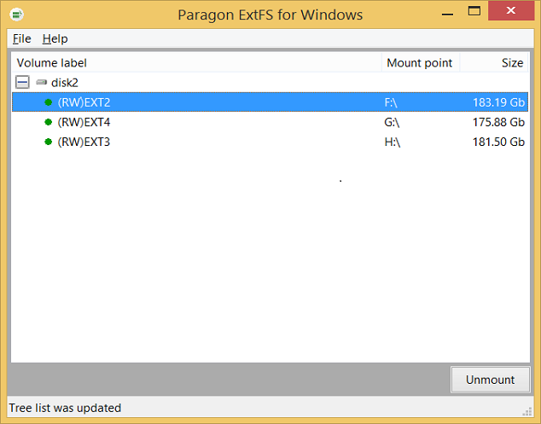
FILE SYSTEM
EXT2
EXT3
EXT4

Slide 10
EXT 2
Ext2 stands for second extended file system.
It was introduced in 1993. Developed by Remy Card.
This was developed to overcome the limitation of the original Ext file system.
Ext2 does not have journaling feature.
On flash drives, USB drives, ext2 is recommended, as it doesn’t need to do the over head of journaling.
To speed up access, the ext2fs uses a technique called a "fast symbolic link."
Maximum individual file size can be from 16 GB to 2 TB
Overall ext2 file system size can be from 2 TB to 32 TB

Slide 11
EXT 3
Ext3 stands for third extended file system.
It was introduced in 2001. Developed by Stephen Tweedie.
Starting from Linux Kernel 2.4.15 ext3 was available.
The main benefit of ext3 is that it allows journaling.
Maximum individual file size can be from 16 GB to 2 TB.
Overall ext3 file system size can be from 2 TB to 32 TB.
There are three types of journaling available in ext3 file system.
Journal – Metadata and content are saved in the journal.
Ordered – Only metadata is saved in the journal. Metadata are journaled only after writing the content to disk. This is the default.
Write back – Only metadata is saved in the journal. Metadata might be journaled either before or after the content is written to the disk.

Slide 12
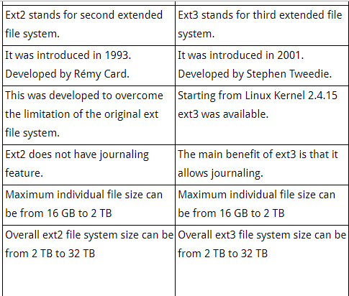
EXT 2 VS EXT 3

Slide 13
EXT 4
Ext4 stands for fourth extended file system.
It was introduced in 2008.
Starting from Linux Kernel 2.6.19 ext4 was available.
Supports huge individual file size and overall file system size.
Maximum individual file size can be from 16 GB to 16 TB
Overall maximum ext4 file system size is 1 EB (exabyte). 1 EB = 1024 PB (petabyte). 1 PB = 1024 TB (terabyte).
In ext4, you also have the option of turning the journaling feature “off”.
You can also mount an existing ext3 fs as ext4 fs without having to upgrade it.

Slide 14
FEATUERS IN EXT4
There are some new features introduced in ext4:
Multi block allocation.
delayed allocation.
journal checksum.
These features improves the performance and reliability of the filesystem when compared to ext3.

Slide 15
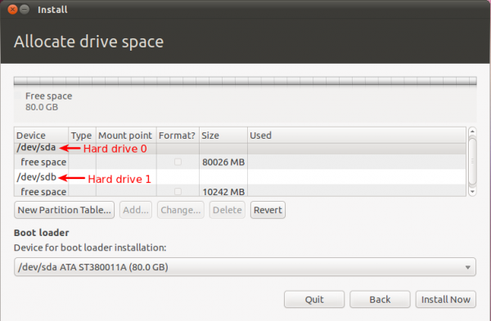
DISK ARRANGEMENT ( ALLOCATING )
Allocate filesystems and swap space to separate partitions or disks Boot files.
Some files must be accessible to the BIOS, UEFI, or boot loader at boot time.
Multiple hard drives.
Potential overflow.
Quotas.

Slide 16
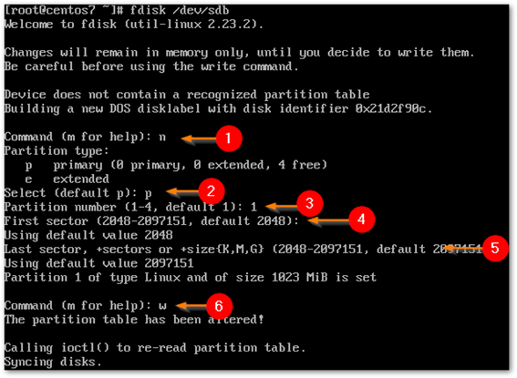
DISK ARRANGEMENT ( PARTITION)
Only two partition root and swap on hard drive.
Directories are created under root.

Slide 17
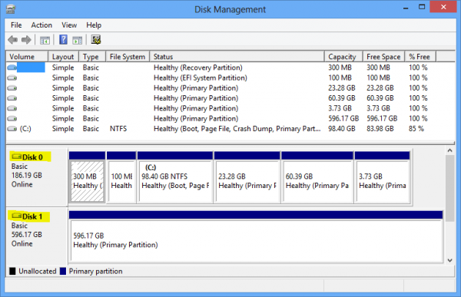
DISK MANAGEMENT ( DYNAMIC)
Improve performance with a striped volume across multiple disks.

Slide 18
DISK MANAGEMENT ( BASIC )
Linux disk management includes several important tasks such as adding or removing storage devices, creating and deleting partitions, mounting partitions on appropriate directories and making file system in partitions.
Improve performance with a striped volume across single disks.

Slide 19
MOUNTING A FILESYSTEM
The mount command mounts a storage device or filesystem, making it accessible and attaching it to an existing directory structure.
$mount
When you type this at a command prompt, this command will display all the mounted devices, the filesystem type it is mounted as, and the mount point. The mount point being local directory that is assigned to a filesystem during the process of mounting.

Slide 20
File & Directory Names
All file names are case sensitive.
You can use upper and lowercase letters, numbers, “.” (dot), and “_” (underscore) symbols.
You can use other special characters such as blank space.
In short, filenames may contain any character except / (root directory), which is reserved as the separator between files and directories in a pathname.
No need to use . (dot) in a filename. Some time dot improves readability of filenames. And you can use dot based filename extension to identify file.
Most modern Linux and UNIX limit filename to 255 characters (255 bytes).

Slide 21
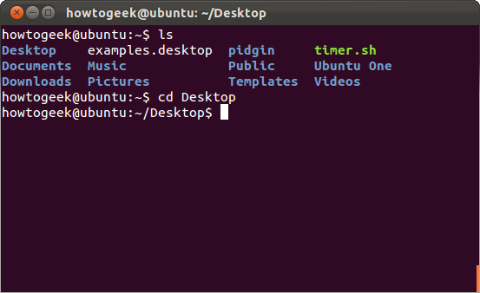
PATH
A path is a unique location to a file or a folder in a file system of an OS. A path to a file is a combination of / and alpha-numeric characters.

Slide 22
WHAT IS AN ABSOLUTE PATH?
An absolute path is defined as the specifying the location of a file or directory from the root directory(/). In other words we can say absolute path is a complete path from start of actual filesystem from / directory.
Some examples of absolute path:
/var/ftp/pub
/etc/samba.smb.conf
boot/grub/grub.conf
If you see all these paths started from / directory which is a root directory for every Linux/Unix machines.

Slide 23
WHAT IS THE RELATIVE PATH?
Relative path is defined as path related to the present working directory(pwd). Suppose I am located in /var/log and I want to change directory to /var/log/kernel. I can use relative path concept to change directory to kernel changing directory to /var/log/kernel by using relative path concept.
cd kernel
Note: If you observe there is no / before kernel which indicates itâs a relative directory to present working directory.
Changing directory to /var/log/kernel using absolute path concept.
cd /var/log/kernel

Slide 24
LISTING DIRECTORY CONTENTS
ls:
You can list the contents of a directory with ls.
paul@debian8:~$ ls
allfiles.txt dmesg.txt services stuff summer.txt

Slide 25
LIST
ls -a
A frequently used option with ls is -a to show all files. Showing all files means including
the hidden files. When a file name on a Linux file system starts with a dot, it is considered
a hidden file and it doesn't show up in regular file listings.
paul@debian8:~$ ls
allfiles.txt dmesg.txt services stuff summer.txt
paul@debian8:~$ ls -a
. allfiles.txt .bash_profile dmesg.txt .lesshst stuff
.bash_history .bashrc services .ssh summer.txt

Slide 26
MOVING, RENAMING FILES & DIRECTORIES
rm & rm -rf
When you no longer need a file, use rm to remove it. Unlike some graphical user interfaces,
the command line in general does not have a waste bin or trash can to recover files. When
you use rm to remove a file, the file is gone. Therefore, be careful when removing files!
paul@debian7:~$ rm BigBattle.txt
paul@debian7:~$ rm -rf test

Slide 27
NAUTILAS
Most people will be used to using graphical tools to copy files from their disks.
If you are used to using Windows then you will be aware of a tool called Windows Explorer which makes it very easy.
Windows Explorer is a tool known as a file manager and Linux has a number of different file managers
This file manager is called Nautilus.

Slide 28
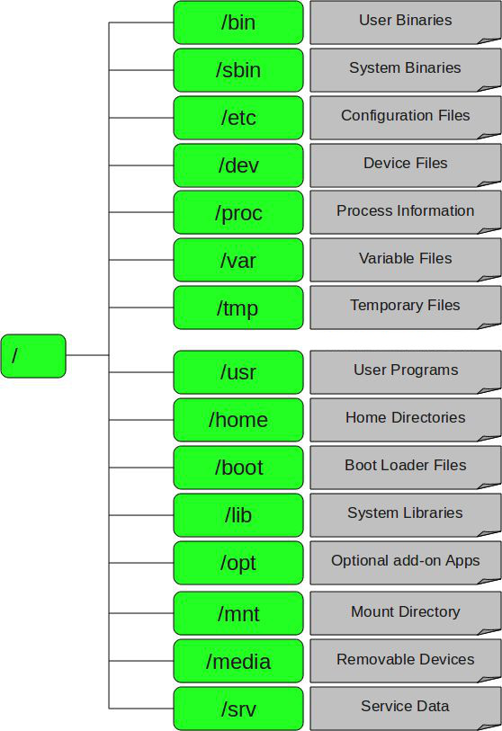
FILE STRUCTURE IN LINUX

Slide 29
FILE STRUCTURE
1. / – Root
Every single file and directory starts from the root directory.
Only root user has write privilege under this directory.
Please note that /root is root user’s home directory, which is not same as /.
2. /bin – User Binaries
Contains binary executables.
Common linux commands you need to use in single-user modes are located under this directory.
Commands used by all the users of the system are located here.
For example: ps, ls, ping, grep, cp.

Slide 30
FILE STRUCTURE
3. /sbin – System Binaries
Just like /bin, /sbin also contains binary executables.
But, the linux commands located under this directory are used typically by system aministrator, for system
maintenance purpose.
For example: iptables, reboot, fdisk, ifconfig, swapon
4. /etc – Configuration Files
Contains configuration files required by all programs.
This also contains startup and shutdown shell scripts used to start/stop individual programs.
For example: /etc/resolv.conf, /etc/logrotate.conf

Slide 31
FILE STRUCTURE
5. /dev – Device Files
Contains device files.
These include terminal devices, usb, or any device attached to the system.
For example: /dev/tty1, /dev/usbmon0
6. /proc – Process Information
Contains information about system process.
This is a pseudo filesystem contains information about running process. For example: /proc/{pid}
directory contains information about the process with that particular pid.
This is a virtual filesystem with text information about system resources. For example: /proc/uptime.

Slide 32
FILE STRUCTURE
7. /var – Variable Files
var stands for variable files.
Content of the files that are expected to grow can be found under this directory.
This includes — system log files (/var/log); packages and database files (/var/lib); emails (/var/mail); print
queues (/var/spool); lock files (/var/lock); temp files needed across reboots (/var/tmp);
8. /tmp – Temporary Files
Directory that contains temporary files created by system and users.
Files under this directory are deleted when system is rebooted.

Slide 33
FILE STRUCTURE
9. /usr – User Programs
Contains binaries, libraries, documentation, and source-code for second level programs.
/usr/bin contains binary files for user programs. If you can’t find a user binary under /bin, look under/usr/bin. For example: at, awk, cc, less, scp
/usr/sbin contains binary files for system administrators. If you can’t find a system binary under /sbin, look under /usr/sbin. For example: atd, cron, sshd, useradd, userdel
/usr/lib contains libraries for /usr/bin and /usr/sbin
/usr/local contains users programs that you install from source. For example, when you install apache fromsource, it goes under /usr/local/apache2
10. /home – Home Directories
Home directories for all users to store their personal files.
For example: /home/john, /home/nikita

Slide 34
FILE STRUCTURE
11. /boot – Boot Loader Files
Contains boot loader related files.
Kernel initrd, vmlinux, grub files are located under /boot
For example: initrd.img-2.6.32-24-generic, vmlinuz-2.6.32-24-generic
12. /lib – System Libraries
Contains library files that supports the binaries located under /bin and /sbin
Library filenames are either ld* or lib*.so.*
For example: ld-2.11.1.so, libncurses.so.5.7

Slide 35
INODE
An inode is a data structure on a filesystem on Linux that stores all the information about a file except its name and its actual data.
The metadata includes
The size of the file .
The file's owner and group.
The file's access permissions.
Timestamps.
Reference number of hardlinks.
Notes:
Stat file name

Slide 36
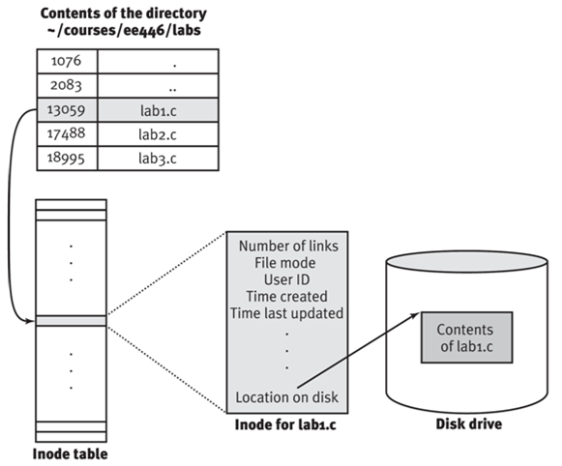
INODE TABLE
Notes:
Ls -i

Slide 37
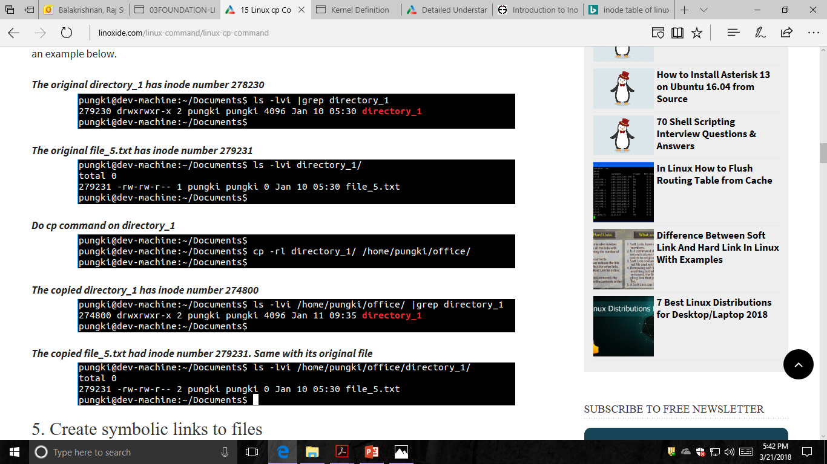
COPY INODE

Slide 38
MOVE INODE
when moving within a filesystem, the inode does not change, only the directory mapping of the inode is changed, the actual data on the hard disk (contents of the file) does not move.
# ls -li samplefile.txt 2497 -rw------- 1 raghu raghu 22 Jun 25 20:12
samplefile.txt
# mv samplefile.txt ..
# ls -li ../samplefile.txt 2497 -rw------- 1 raghu raghu 22 Jun 25 20:12
../samplefile.txt

Slide 39
REMOVE INODE
First find out file inode number with any one of the following command:
stat {file-name}
OR
ls -il {file-name}
Use find command to remove file:
Use find command as follows to find and remove a file:
find . -inum [inode-number] -exec rm -i {} \;
When prompted for confirmation, press Y to confirm removal of the file

Slide 40


